Slide 1
Compiler Construction
Teacher : Zulfiqar Ali
Email: Zulfiqar.rafique@nu.edu.pk
Office: No.6,Basement -1 (CS Block 1)

Slide 2
Week 4:
Syntax Definition
Definition of Grammar
Derivations
Left Derivation
Right Derivation
Tree Derivation
Ambiguity
Prcedence issues
Associativity issues

Slide 3
Syntax Definition
The “Context-free grammar," or ”Grammar" for short - that is used to specify the syntax of a language.
A grammar naturally describes the hierarchical structure of most programming language constructs.
For example, an if-else statement in Java can have the form
Statement ->if (expr) statement else statement

Slide 4
if ( expression ) statement else statement
That is, an if-else statement is the concatenation of the keyword if, an opening parenthesis, an expression, a closing parenthesis, a statement, the keyword else, and another statement.
Using the variable expr to denote an expression and the variable stmt to denote a statement, this structuring rule can be expressed as
stmt -> if ( expr ) stmt else stmt

Slide 5
stmt -> if ( expr ) stmt else stmt
in which the arrow may be read as "can have the form." Such a rule is called a production.
In a production, lexical elements like the keyword if and the parentheses are called terminals. Variables like expr and stmt represent sequences of terminals and are called non terminals.

Slide 6
Definition of Grammar
We specify grammars by listing their productions, with the productions for the start symbol listed first.
We assume that digits, signs such as < and <=, and boldface strings such as while are terminals.
An italicized name is a, and any non italicized name or symbol may be assumed to be a terminal.
For notational convenience, productions with the same non terminal as the head can have their bodies grouped, with the alternative bodies separated by the symbol.

Slide 7
Regular Grammar
According to Noam Chomsky there are 4 types of grammar
Grammar Type | Grammar Accepted | Language Accepted | Automation
Type 0 | Un Restricted Grammar | Recursively Enumerable Language | Turing Machine
Type 1 | Context Sensitive Grammar | Context Sensitive Language | Linear Bounded Automaton
Type 2 | Context Free Grammar | Context Free Language | Pushdown Automata
Type 3 | Regular Grammar | Regular Language | Finite Automata

Slide 8
Definition of Grammar (CFG)
A context-free grammar has four components
A set of terminal symbols (Tokens)
A set of non-terminals, sometimes called \syntactic variables.“
A set of productions composed of
left side: a nonterminal
arrow: ->
right side: a sequence of terminals and non terminals
A start symbol (first production is for the start symbol)
Productions with the same left side can be grouped (separated by |)

Slide 9
Context Free Grammar
Context Free Grammar is formal grammar, the syntax or structure of a formal language can be described using context-free grammar (CFG), a type of formal grammar.
V - It is the collection of variables or nonterminal symbols.
T - It is a set of terminals.
P - It is the production rules that consist of both terminals and non terminals.
S - It is the Starting symbol.

Slide 10
Grammar
A Grammar G can be formally described using 4 tuples G=(V, T, S, P)
Example: G=({S,A,B), {a,b}, S, {S→AB, A→a, B→b})
Here V={S,A,B}, T={a, b}, S=S and P= {S→AB, A→a, B→b})
S->AB
->aB
->ab

Slide 11
Derivation of Grammar
A grammar derives strings by beginning with the start symbol and repeatedly replacing a nonterminal by the body of a production for that nonterminal. The terminal strings that can be derived from the start symbol form the language defined by the grammar.

Slide 12
Example
G=({S,A}, {a, b}, S, {S->aAb, aA->aaAb, A-E})
S->aAb [S->aAb]
S->aaAbb [aA->aaAb]
S->aaaAbbb [aA->aaAb]
S->aaabbb [A->E]

Slide 13
Understand with English Grammar
Students are awesome
Students | are | awesome
Noun | Verb | Adjective
UIT | Is | Good
 | Verb Phrase
Sentence

Slide 14
Understand with English Grammar
Nouns | Variables Or Non-Terminals | Constants Or Terminals | Students
Adjectives |  |  | UIT
Verb Phrase |  |  | Are, is
Sentense |  |  | Awesome
 |  |  | Good
G = (V,T,S,P)
V= Non terminal
T= Terminal
P = Production Rule
S= <S>
S -> Noun + Verb Phrase
Verb Phrase = Verb + Adjective
Noun-> Students, UIT
Verb - > is, are
Adjective -> Awesome Good

Slide 15
Derivations in CFG
A CFG list->list+list | list x list | digit OR
list->list+list
List->list x list
List->digit
CFG has (V T P S), here V=list, T =+ x digit, P is above given rules and S is any string derive from the rules.
Digit->0-9

Slide 16
Derivations in CFG
A grammar derives strings by beginning with the start symbol and repeatedly replacing a nonterminal by the body of a production for that nonterminal. The terminal strings that can b e derived from the start symbol form the language defined by the grammar.

Slide 17
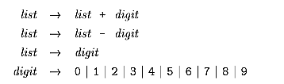

Example
The bodies of the three productions with nonterminal list as head equivalently can b e grouped:
According to our conventions, the terminals of the grammar are the symbols

Slide 18
Suppose we want to derive 9-5+2 from the given productions.
Taking the first production List->list+digit we may drive list->list+2
Now taking second product list-digit we may drive list-digit+2
we will replace digital with 5, we will have list-5+2
Now from left most list we drive digit then we have digit-5+2
After replacing digit with 9, we will have 9-5+2

Slide 20
Types of Derivations
Left Most Derivation
Right most derivation
Parse tree

Slide 21
Left most derivation
In the leftmost derivation, the input is scanned and replaced with the production rule from left to right. So in leftmost derivation, we read the input string from left to right.

Slide 22
Left most derivation
Let derive the string Digit + Digit x Digit using left most derivation using the given production.digit->0-9
list->list+list | list x list | digit
Let choose best rule first to derive above string
List->list+list
List->digit+list
List->digit+list x list
-list->digit+digit x list
list>->digit + digit x digit

Slide 23
Right most derivation
In rightmost derivation, the input is scanned and replaced with the production rule from right to left. So in rightmost derivation, we read the input string from right to left.

Slide 24
Right Most Derivation
Lets derive the same string digit + digit x digit using right most with same rules.
list->list+list | list x list | digit
Lets choose the best rule first to derive above string
List -> list + list
List->list + list x list
list -> list + list x digit
List -> list + digit x digit
List -> digit + digit x digit

Slide 25
Parse Tree Derivation
Parse tree Derivation tree is a graphical representation for the derivation of the given production rules for a given CFG. It is the simple way to show how the derivation can be done to obtain some string from a given set of production rules.
Parse tree follows the precedence of operators. The deepest sub-tree traversed first. So, the operator in the parent node has less precedence over the operator in the sub-tree.

Slide 26
Parse Tree Derivation
A parse tree contains the following properties:
The root node is always a node indicating start symbols.
The derivation is read from left to right.
The leaf node is always terminal nodes.
The interior nodes are always the non-terminal nodes.

Slide 27
Parse Tree Derivation
For Example: We have a grammar
list->list+list | list x list | digit
We want to derive a string digit x digit + digit
list
digit
List
+
List
digit
list
X
List
digit

Slide 28
Ambiguity in Derivations
We have to b e careful in talking about the structure of a string according to a grammar.
A grammar can have more than one parse tree generating a given string of terminals. Such a grammar is said to be ambiguous.
To show that a grammar is ambiguous, all we need to do is find a terminal string that is the yield of more than one parse tree.
Since a string with more than one parse tree usually has more than one meaning, we need to design unambiguous grammars for compiling applications, or to use ambiguous grammars with additional rules to resolve the ambiguities.

Slide 29
Ambiguity Examples
Tree in previous slide shows that an expression like 9-5+2 has more than one parse tree with this grammar.
The two trees for 9-5+2 correspond to the two ways of parenthesizing the expression: (9-5)+2 and 9-(5+2).
This second parenthesization gives the expression the unexpected value 2 rather than the customary value 6.
Associativity

Slide 30
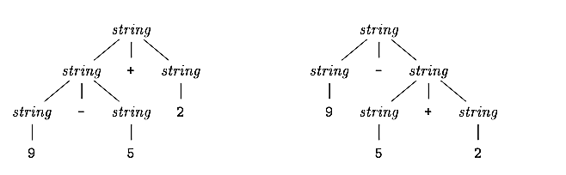
Ambiguity Examples
Suppose we used a single nonterminal string and did not distinguish between digits and lists. Following is a rule/grammar.

Slide 31
Associativity of Operators
By convention, 9+5+2 is equivalent to (9+5)+2 and 9-5-2 is equivalent to (9-5)-2.
When an operand like 5 has operators to its left and right, conventions are needed for deciding which operator applies to that operand.
We say that the operator + associates to the left, because an operand with plus signs on both sides of it belongs to the operator to its left.
In most programming languages the four arithmetic operators, addition, subtraction, multiplication, and division are left-associative.

Slide 32

Associativity of Operators
Some common operators such as exponentiation are right-associative.
As another example, the assignment operator = in C and its descendants is right-associative; that is, the expression a=b=c is treated in the same way as the expression a=(b=c).
Strings like a=b=c with a right-associative operator are generated by the following grammar.

Slide 33
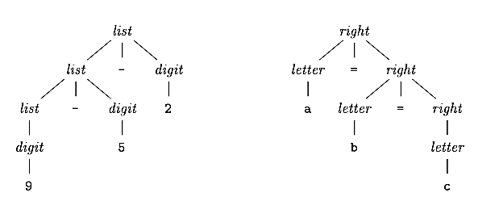
Associativity of Operators

Slide 34
Precedence of Operators
Consider the expression 9+5*2. There are two possible interpretations of this expression: (9+5)*2 or 9+(5*2).
The associativity rules for + and * apply to occurrences of the same operator, so they do not resolve this ambiguity.
Rules defining the relative precedence of operators are needed when more than one kind of operator is present.
We say that * has higher precedence than + if * takes its operands before + does.

Slide 35
Precedence of Operators
In ordinary arithmetic, multiplication and division have higher precedence than addition and subtraction.
Therefore, 5 is taken by * in b oth 9+5*2 and 9*5+2; i.e., the expressions are equivalent t 9+(5*2) and (9*5)+2, respectively.

Slide 36
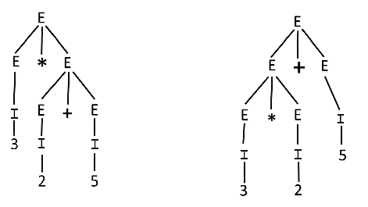
Precedence of Operators

Slide 37
Exercises
Determine whether the following grammars are ambiguous or not
S-> (S)| SS | E using the string ( )( )( ).
S->SbS | a using the string ababa
S->aB|ab, A->AB|a, B->Abb|b using string ab

Slide 38
Associativity solution in CFGs
Associativity issue can be resolved by restricting the Grammar.
Example: Consider a grammar
E->E+E, E->E-E, E->digit 9-5 +2
E-> E+digit
E->E-digit
E->digit

Slide 39
E->E+E, E->E-E, E->digit
For a string digit+digit-digit (9+4-5) we have a parse trees.
E
E
E
+
E
E
-
E
9
E
-
E
E
+
E
5
4
5
9
4

Slide 40
Lets restrict the grammar
E->E+E, E->E-E, E->digit
E->E+E Updated to E->E+digit to enable it for left associative, because + is left assoc..
E->E-E is updated to E->E-digit
E->digit it will remain same
E
E
-
digit
E
+
digit
5
9
4

Slide 41
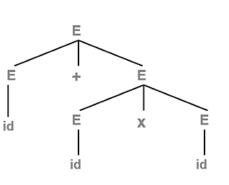
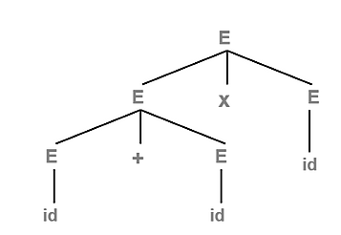
Precedence solutions in CFGs
We have a grammar and a string id+idxid
E->E+E E->ExE E->id
But there are other ways to illustrate parse trees, but that will lead incorrect result.
Correct Parse Tree
Incorrect Parse Tree

Slide 42
E->E+E | E x E | Id 5+3 x 4 +3
E->E+T |T
T->TxF |F
F->Id

Slide 43
Precedence solutions in CFGs
Precedence issue can be resolved by restricting the grammar. Let restring the first rule 1. E->E+E.
1. E->E+E as we know that + is left associative and has less precedence than x.so + should expand first.
To restrict it to left associative we to stop it grow from right, we will update the rule to1. E->E+T.
The 2nd rule will be rewritten as T->TxT but x is also left, so make it left recursive, update it to 2. T->TxF.
E->E+T , T->TxF

Slide 44
Precedence solutions in CFGs
Remember from the Grammar E->E+E | ExE | id E is also directly giving id, so will update our first rule to 1. E->E+T | T.
Third rule will be F->id
we should be able write id directly from E, so will update rule 2 2. T->TxF | F
so our final all production rules are
E->E+T | T
T=TxF | F
F-> id

Slide 45
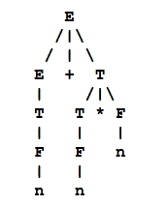
Precedence solutions in CFGs
Lets drive the string id+idxid or n+n x n using the rules
E->E+T | T
T=TxF | F
F-> id

Slide 46
Parsing
Parsing is the process of determining how a string of terminals can b e generated by a grammar.
In discussing this problem, it is helpful to think of a parse tree being constructed, even though a compiler may not construct one, in practice.
However, a parser must b e capable of constructing the tree in principle, or else the translation cannot b e guaranteed correct

Slide 47
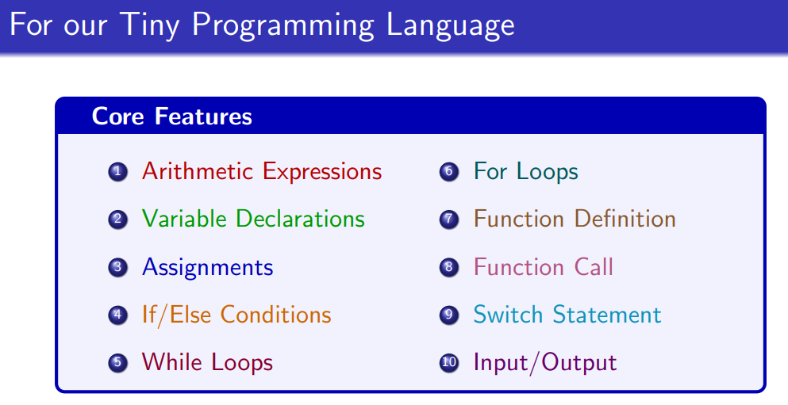

Slide 48
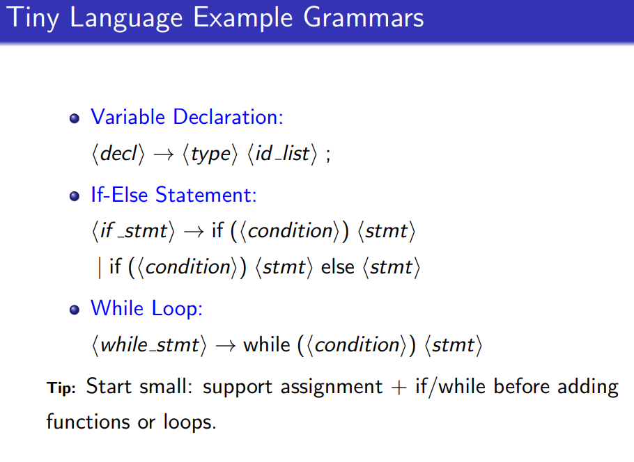
<stmnt>-> <if_stmt> |
<if_stmt>->if(<condition>)stmnt

Slide 49
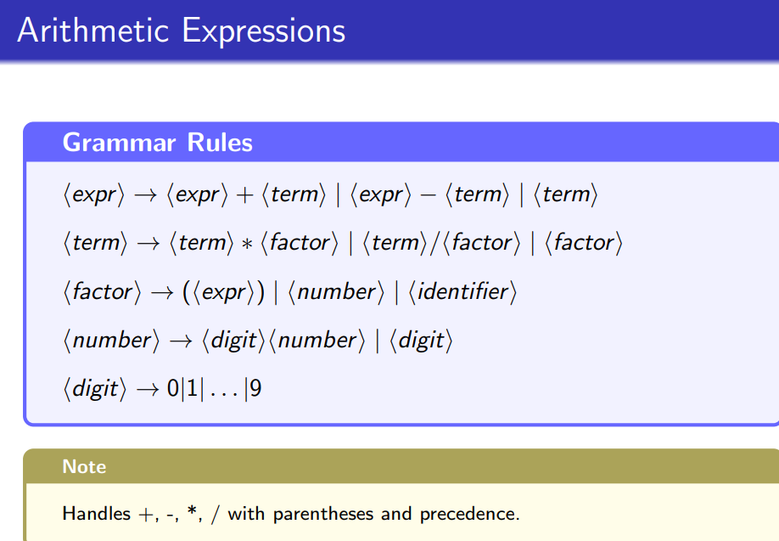

Slide 50
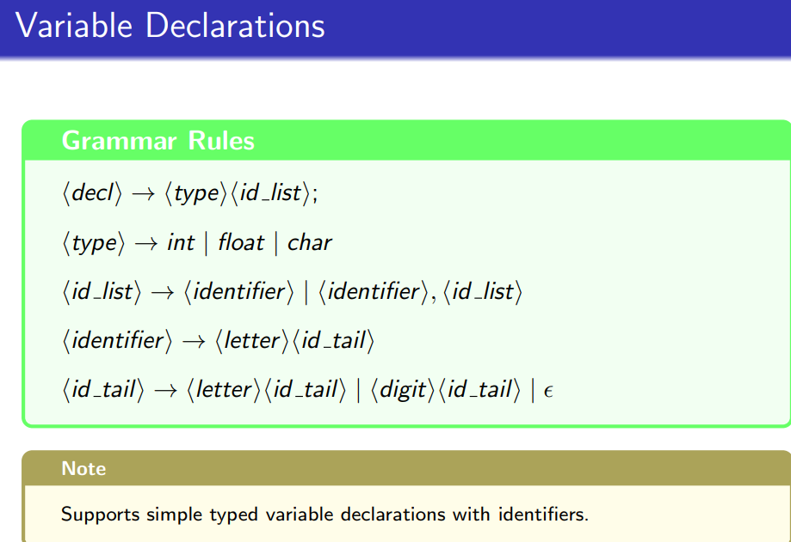

Slide 51
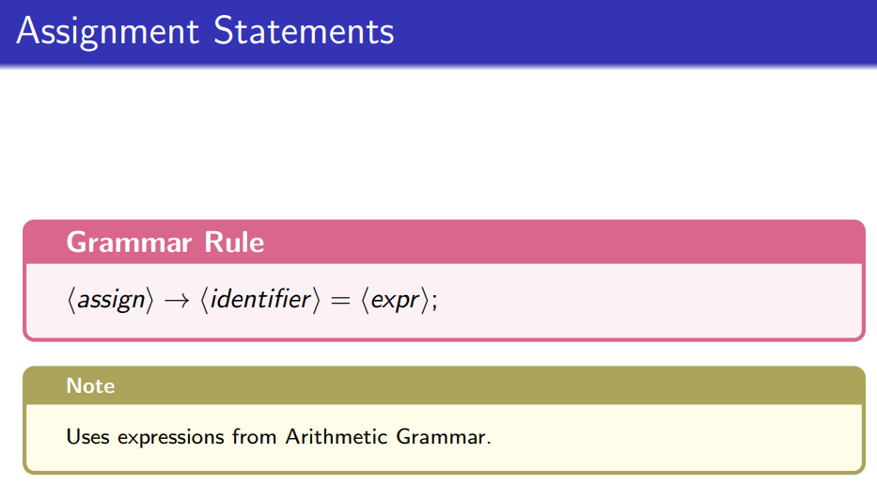

Slide 52
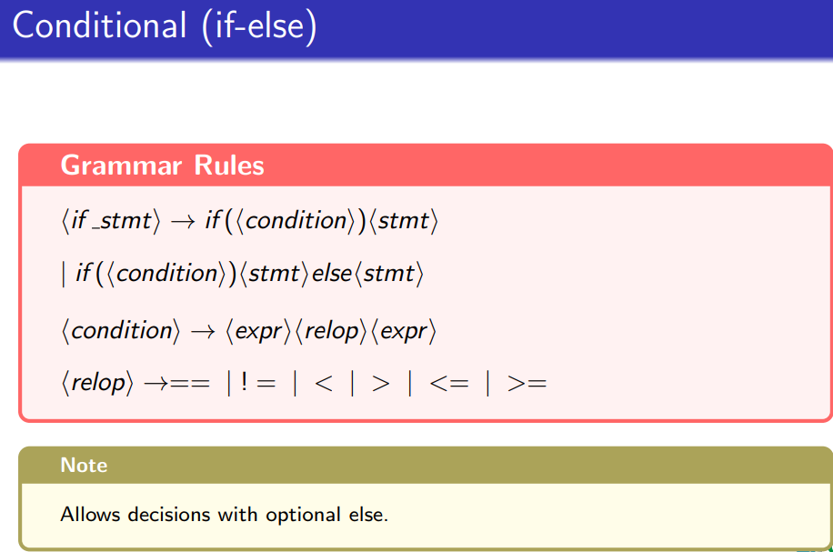

Slide 53
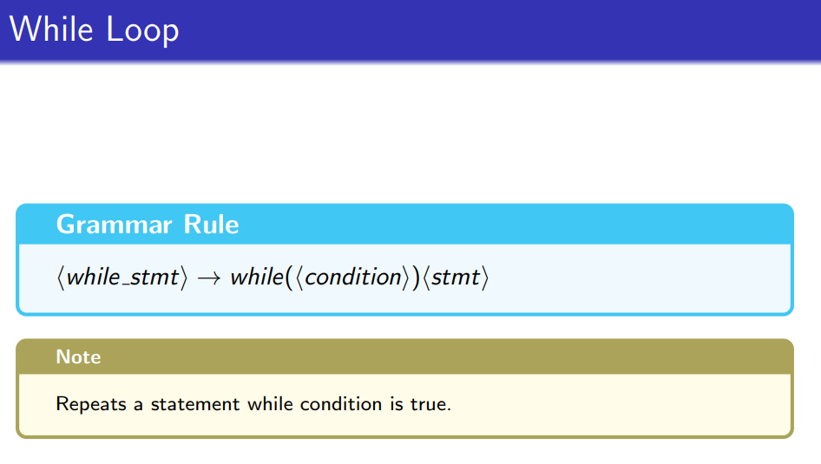

Slide 54
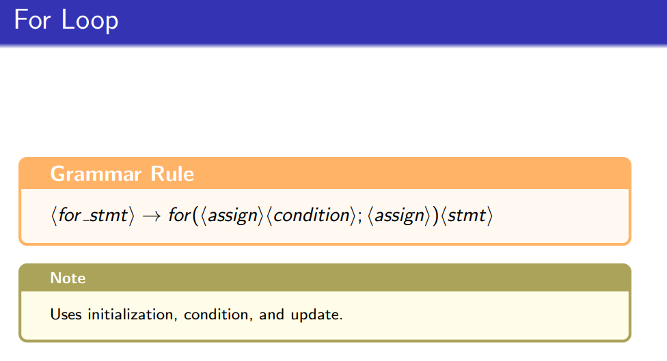

Slide 55
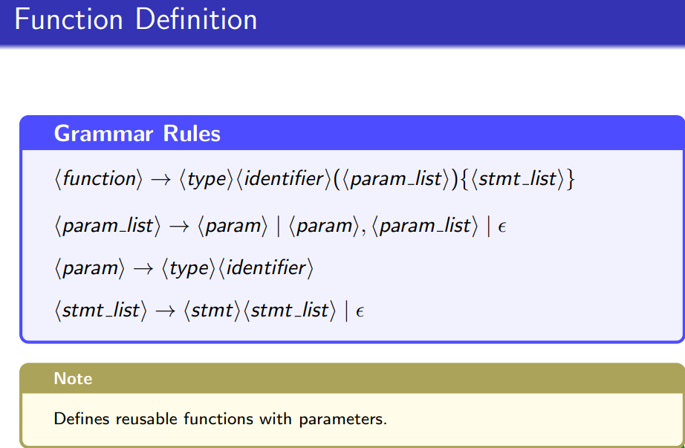

Slide 56
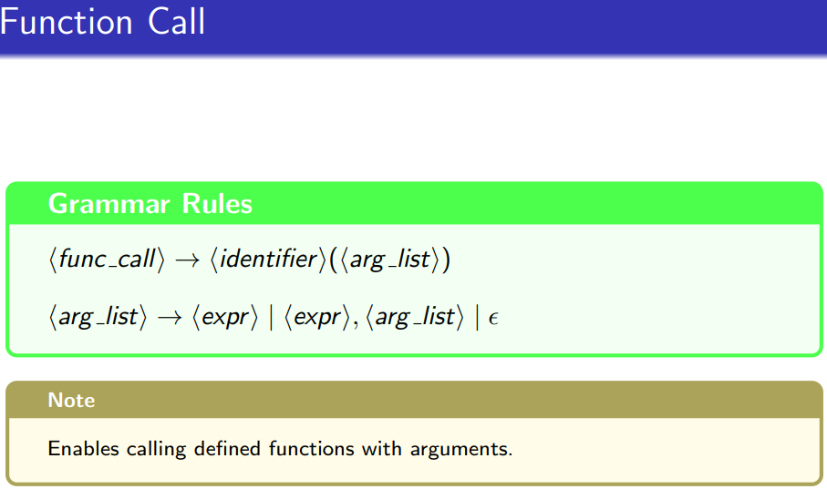

Slide 57
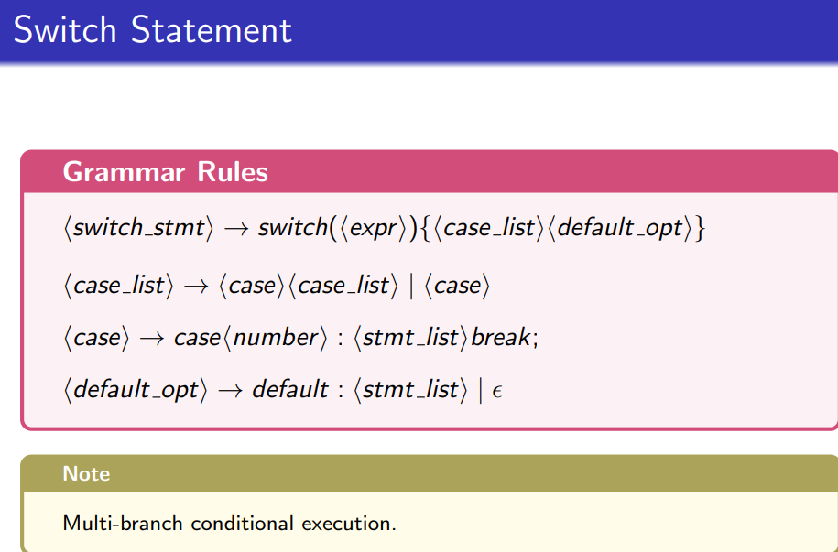

Slide 58
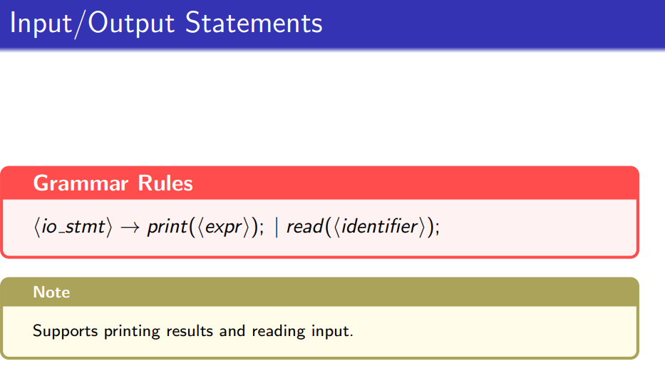

Slide 59
Examples: source code- Lexical- Syntax(CFG)
int x = 10;
float y = 5.5;
if (x > y) {
print(x);
} else {
y = y * 2;
print(y);
}
while (x < 20) {
x = x + 1;
}

Slide 60
Token Generation - 1
Lexeme | Token Type | Matches Grammar Terminal
int | TYPE | int
x | IDENTIFIER | ⟨identifier⟩
= | ASSIGN_OP | =
10 | NUMBER | ⟨number⟩
; | SEMICOLON | ;
float | TYPE | float
y | IDENTIFIER | ⟨identifier⟩
= | ASSIGN_OP | =
5.5 | NUMBER | ⟨number⟩
; | SEMICOLON | ;
if | IF_KEYWORD | if
( | LEFT_PAREN | (
Lexeme | Token Type | Matches Grammar Terminal
x | IDENTIFIER | ⟨identifier⟩
> | RELOP | >
y | IDENTIFIER | ⟨identifier⟩
) | RIGHT_PAREN | )
{ | LEFT_BRACE | {
print | PRINT_KEYWORD | print
( | LEFT_PAREN | (
x | IDENTIFIER | ⟨identifier⟩
) | RIGHT_PAREN | )
; | SEMICOLON | ;
} | RIGHT_BRACE | }
else | ELSE_KEYWORD | else

Slide 61
Token Generation - 2
Lexeme | Token Type | Matches Grammar Terminal
{ | LEFT_BRACE | {
y | IDENTIFIER | ⟨identifier⟩
= | ASSIGN_OP | =
y | IDENTIFIER | ⟨identifier⟩
* | MULT_OP | *
2 | NUMBER | ⟨number⟩
; | SEMICOLON | ;
print | PRINT_KEYWORD | print
( | LEFT_PAREN | (
y | IDENTIFIER | ⟨identifier⟩
) | RIGHT_PAREN | )
; | SEMICOLON | ;
} | RIGHT_BRACE | }
Lexeme | Token Type | Matches Grammar Terminal
while | WHILE_KEYWORD | while
( | LEFT_PAREN | (
x | IDENTIFIER | ⟨identifier⟩
< | RELOP | <
20 | NUMBER | ⟨number⟩
) | RIGHT_PAREN | )
{ | LEFT_BRACE | {
x | IDENTIFIER | ⟨identifier⟩
= | ASSIGN_OP | =
x | IDENTIFIER | ⟨identifier⟩
+ | PLUS_OP | +
1 | NUMBER | ⟨number⟩
; | SEMICOLON | ;
} | RIGHT_BRACE | }

Slide 62
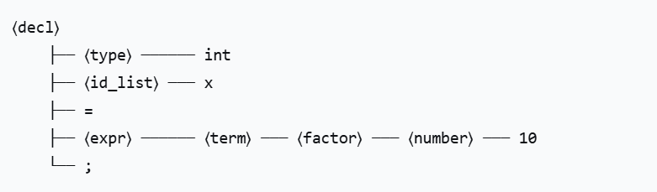
Implementing CFG with above tokens Variable Declaration
Variable Declaration Parse Tree
Source Code: int x = 10;
Token Stream:
TYPE(int) → IDENTIFIER(x) → ASSIGN_OP(=) → NUMBER(10) → SEMICOLON(;)

Slide 63
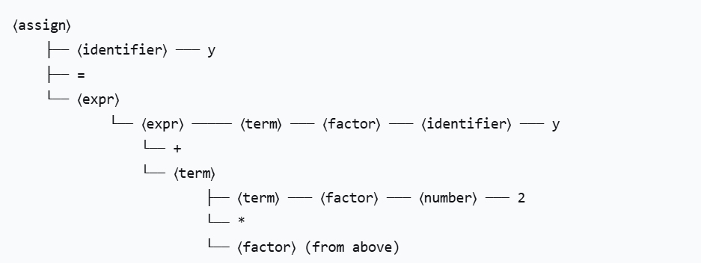
Assignment statement
Source Code: y = y * 2;
Token Stream:
IDENTIFIER(y) → ASSIGN_OP(=) → IDENTIFIER(y) → MULT_OP(*) → NUMBER(2) → SEMICOLON(;)

Slide 64
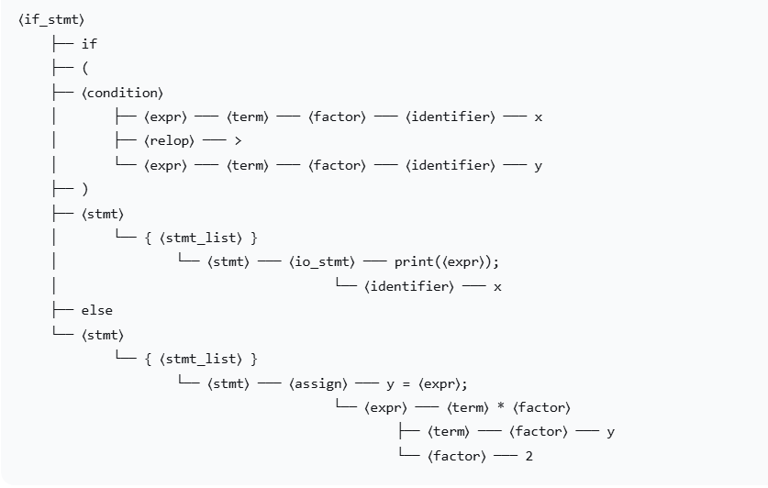
If-Else Statement
Source Code: if (x > y) { print(x); } else { y = y * 2; }

Slide 65
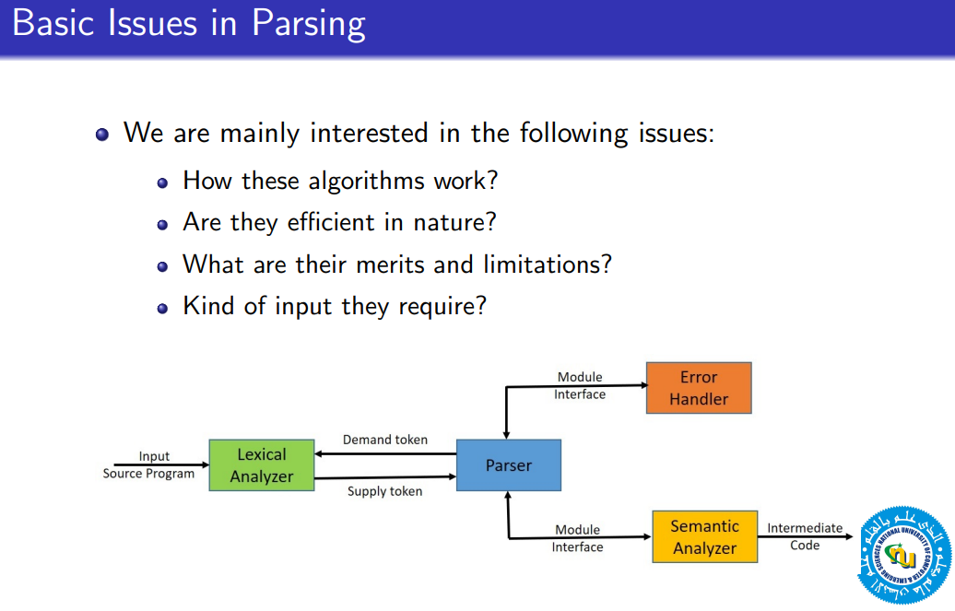

Slide 66
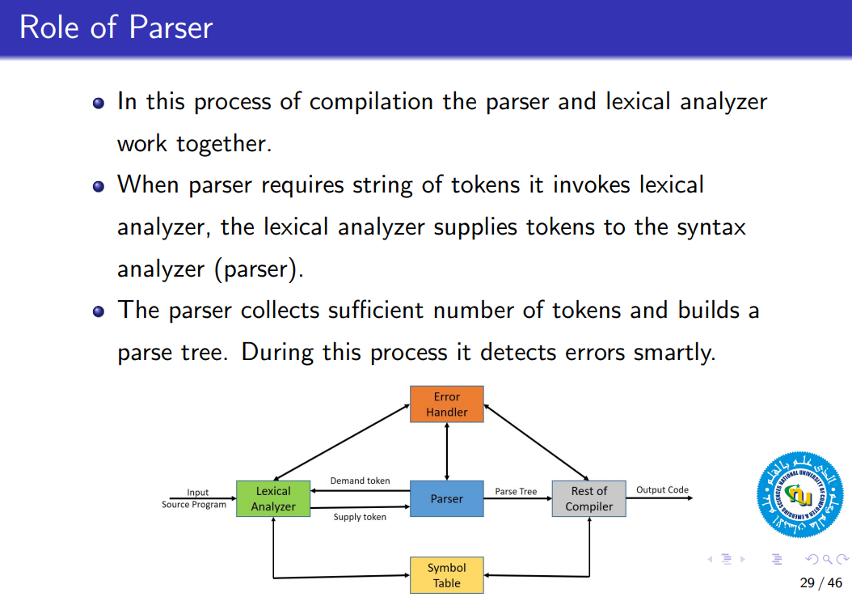

Slide 67
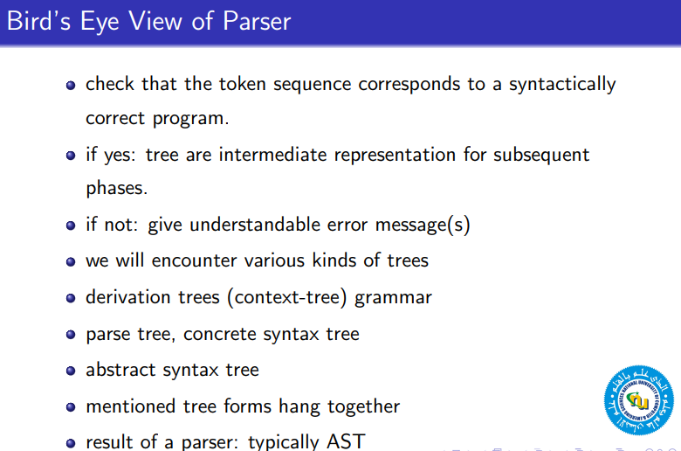

Slide 68
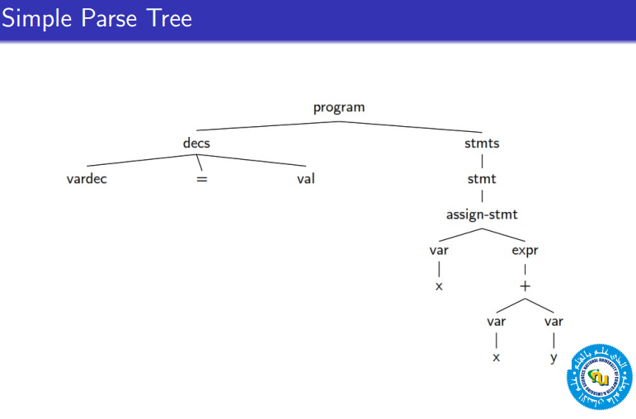

Slide 69
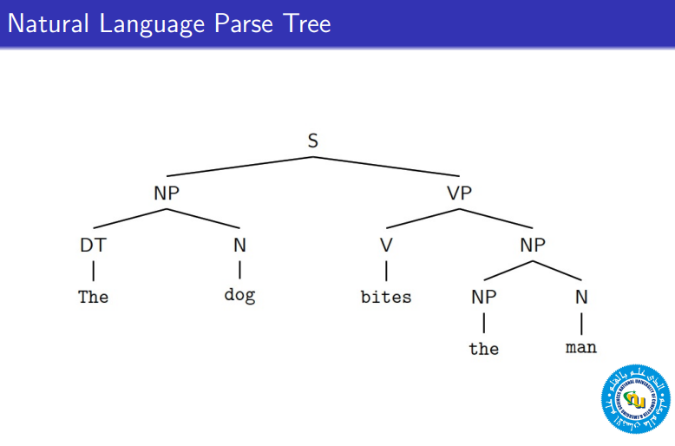

Slide 70
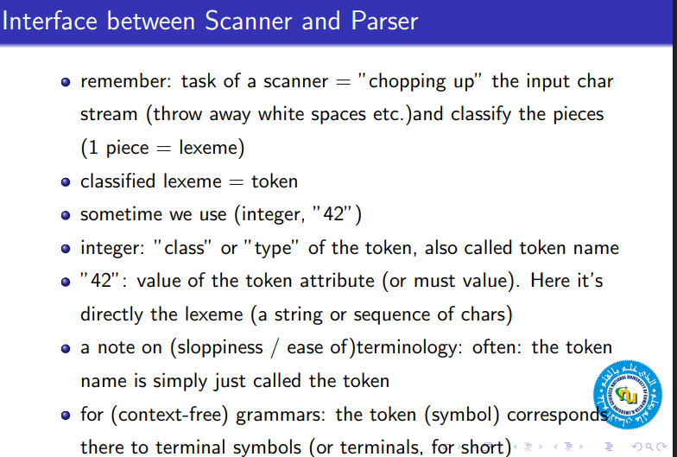

Slide 71
Parsing
A parsing method called \recursive descent," which can be used both to parse and to implement syntax-directed translators.
For any context-free grammar there is a parser that takes at most O (n³ ) time to parse a string of n terminals. But cubic time is generally too expensive.
Fortunately, for real programming languages, we can generally design a grammar that can be parsed quickly.

Slide 72
Parsing
Most parsing methods fall into one of two classes, called the top-down and bottom-up methods.
These terms refer to the order in which no des in the parse tree are constructed.

Slide 73
Top Down Parsing
The top–down parser starts by constructing the parse tree with a single node labeled with the start symbol. It can then build up the complete parse tree by creating the subtrees one by one, in a left-to-right order.
In building a subtree, the root node of that subtree is created and than all the sub-subtrees of that subtree are generated.
This is a recursive algorithm, generating the tree in pre-order (node, then its subtrees in a left-to-right order).

Slide 74
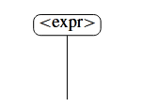
Parse Trees and the Leftmost Derivation
Our task is to illustrate the parsing of x+y*z.
The next step in the pre-order generation is to set up the leftmost subnode.
This is done by looking at the grammar of the language and noting that <expr> is defined as
<expr> ::= <term> | <expr> + <term>

Slide 75
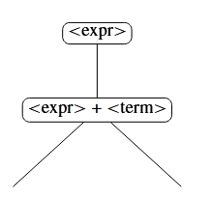
Which alternative should be chosen? This turns out to be a difficult issue because of the characteristics of this grammar. We choose the <expr> ::= <expr> + <term>.

Slide 76
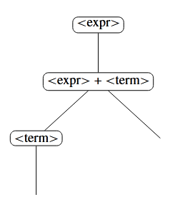
We then have to deal with the nodes and their subtrees from left to right. This time we use the production <expr> ::= <term> and the tree becomes:

Slide 77
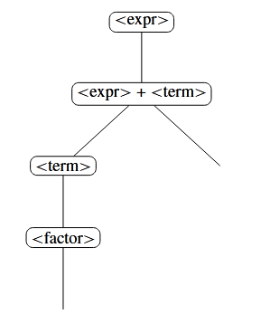
The lower <term> node has to be tackled next. Use the production <term> ::= <factor>

Slide 78
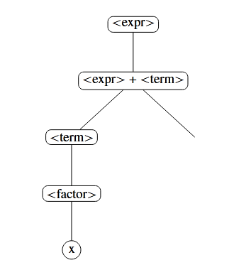
The <factor> node is given a single child via the production <factor> ::= x

Slide 79
Since we have ended this branch of the tree with a terminal symbol, this symbol is matched with the input. Our input is x+y*z, the x is matched and the remaining input is +y*z. We then unwind from the recursion all the way back up to deal with the <expr> + <term> node. We have just dealt with the leftmost <expr>
node and its children, so we now tackle the node +. This again is matched with the input and so y*z remains. The next step is to deal with the third node <term>. We use the
<term> ::= <term> * <factor>

Slide 80
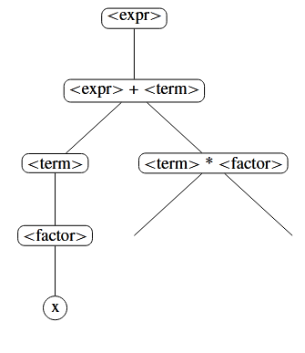
Then the tree becomes.

Slide 81
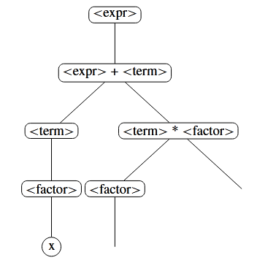
The latest <term> is given the child <factor> from the production <term> ::= <factor>

Slide 82
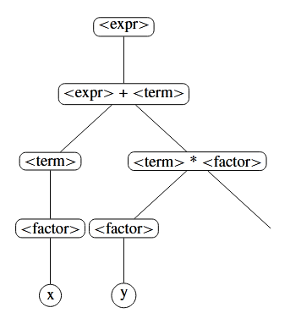
That <factor> corresponds to y. We use the production <factor> ::= y

Slide 83
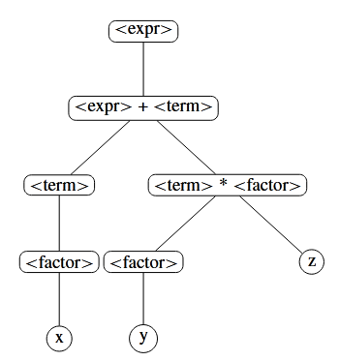
This y is matched with the input and the remaining input is *z. The recursion returns to the * node which again is matched with the input, resulting in just z remaining. Finally we use the production <factor> ::= z

Slide 84
C Statement Top-Down Parsing
The grammar in Fig. 2.16 generates a subset of the statements of C or Java. We use the bold face terminals if and for for the keywords \if" and \for", respectively, to emphasize that these character sequences are treated as units, i.e., as single terminal symbols.
Further, the terminal expr represents expressions; a more complete grammar would use a nonterminal expr and have productions for nonterminal expr. Similarly, other is a terminal representing other statement constructs.

Slide 85
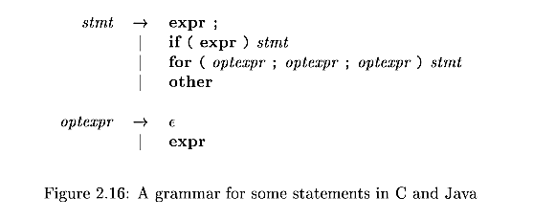

Slide 86
The top-down construction of a parse tree like the one in Fig. 2.17, is done by starting with the root, labeled with the starting nonterminal stmt, and repeatedly performing the following two steps.
At node N , labeled with nonterminal A, select one of the productions for A and construct children at N for the symbols in the production body.
Find the next no de at which a subtree is to b e constructed, typically the leftmost unexpanded nonterminal of the tree.
For some grammars, the above steps can be implemented during a single left-to-right scan of the input string.

Slide 87
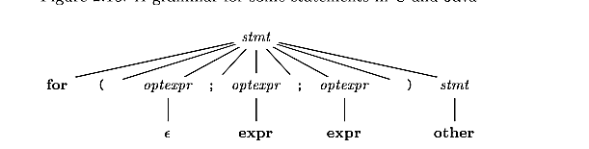

Slide 88
The current terminal being scanned in the input is frequently referred to as the lookahead symbol (The lookahead symbol is simply the next terminal that we will try to match in the input ). Initially, the lookahead symbol is the first, i.e., leftmost, terminal of the input string.

Slide 89
Bottom Up Parsing
Bottom-up parsers, in contrast, start with the first token of the input. Their mode of operation may seem very much more intuitive than top–down parsing.
They repeatedly match symbols from the input with the strings on the right-hand sides of production rules,+ replacing the matched strings with the corresponding left-hand sides. This continues until, hopefully, just the starting symbol remains.
The correct order of matching for the bottom-up parser is defined by the right- most derivation. The bottom-up parser has to perform the rightmost derivation in reverse. This produces the canonical parse.

Slide 90
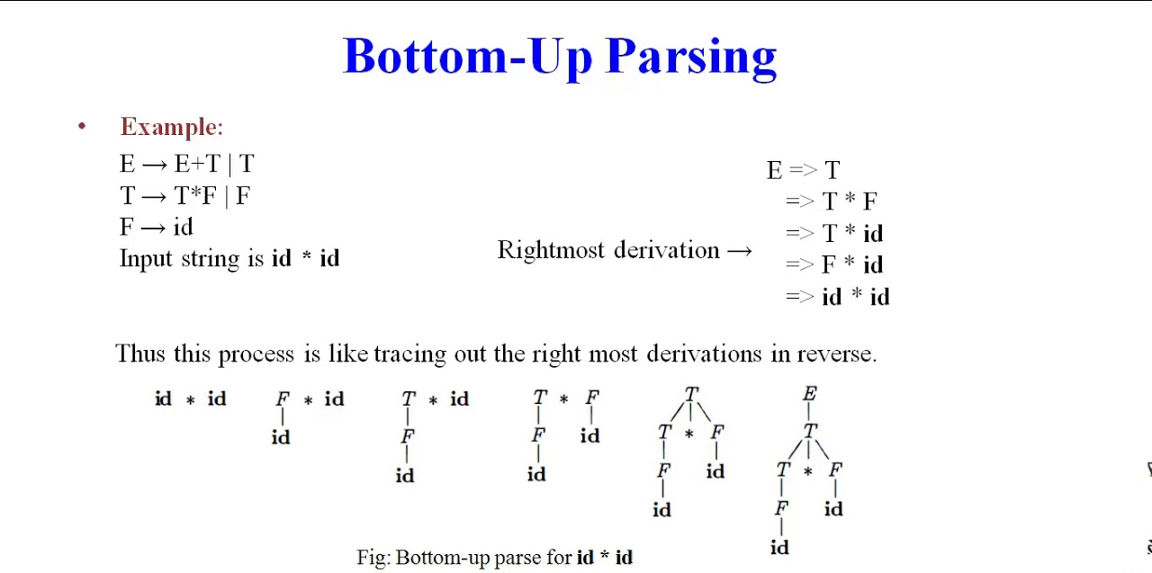

Slide 91

Exapmle
If we start with the input x+y*z from using the following grammar and reverse the rightmost derivation, we can see how the bottom-up parser should operate:

Slide 92
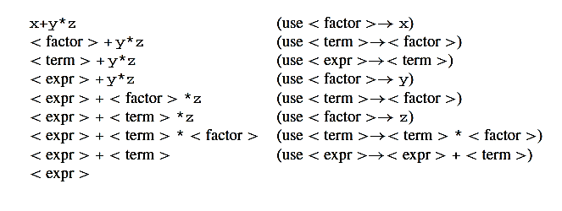

Slide 93
Classification of Parsing
The parser is mainly classified into two categories, i.e. Top-down Parser, and Bottom-up Parser.
Further Top-down parser is classified into 2 types: A recursive descent parser, and Non-recursive descent parser.
Further Bottom-up parser is classified into two types: LR parser, and Operator precedence parser.

Slide 94
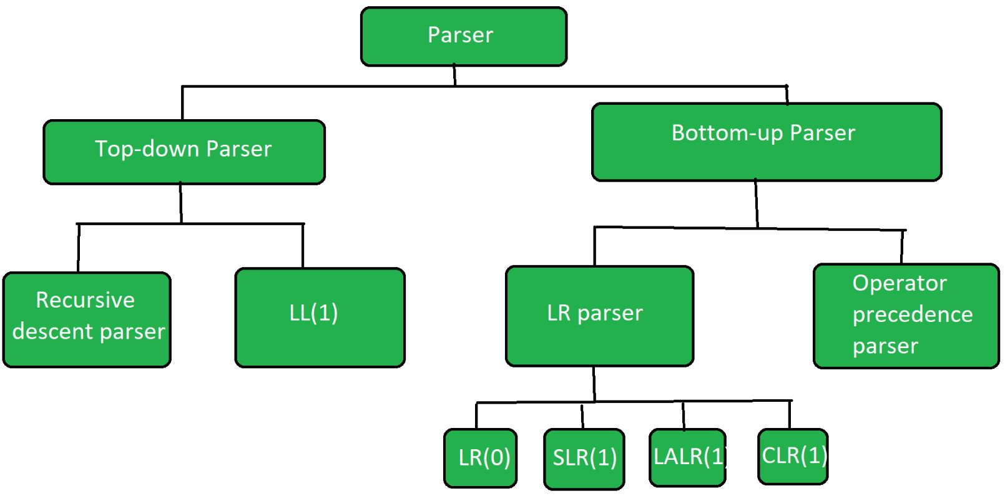

Slide 95
Top Down Parser Classification
Recursive Descent Parsing:
Recursive descent parsing is a type of top-down parsing technique. This technique follows the process for every terminal and non-terminal entity. It reads the input from left to right and constructs the parse tree from right to left. As the technique works recursively, it is called recursive descent parsing.
Non-recursive descent parser
It is also known as LL(1) parser or predictive parser or without backtracking parser or dynamic parser. It uses a parsing table to generate the parse tree instead of backtracking.

Slide 96
Bottom-up Parsing Classification
Bottom-up parser is classified into two types: LR parser, and Operator precedence parser.
LR Parser: is the bottom-up parser that generates the parse tree for the given string by using unambiguous grammar. It follows the reverse of the rightmost derivation. ( Types:(a) LR(0) (b) SLR(1) (c) LALR(1) (d) CLR(1))
Operator precedence parser generates the parse tree from given grammar and string but the only condition is two consecutive non-terminals and epsilon never appears on the right-hand side of any production.

Slide 97
Home Work
You are required to write a code which works as Initial Scanner
Your Lexical Analyzer must generate tokens From following type of English sentences. a. the big dog chases a small cat b. a jumpy bear sees the orange apple c. an itchy small cat likes the big dog d. the dog hugs a jumpy bear e. a big itchy jumpy orange apple chases the cat f. The an a itchy bear hugs the a an jumpy dog.
You may have following type of Tokens
Det(Determiner) = {"the", "a", "an"} Adj = {"itchy", "jumpy", "big", "small", "orange"} N = {"bear", "dog", "cat", "apple", "orange"} V = {"hugs", "sees", "chases", "likes"}

Slide 98
Reference:
Compilers: Principles, Techniques, and Tools 2nd Edition by Alfred Aho , Jeffrey Ullman, Ravi Sethi, Monica Lam
Introduction to Compilers and Language Design | Second Edition | Prof. Douglas Thain - University of Notre Dame

